Slide 1
Instagram user analytics
Project no. 2 – using sql fundamentals

Slide 2
Agenda
Let’s dive into the project agenda which will be as follows:
Project Description.
Approach.
Tech – stack used.
Insights.
Result.

Slide 3
Project description
In this project we would be using SQL Fundamentals and MySQL Workbench to analyze user interaction with the Instagram App.
The aim of this project Is to find out required and necessary insights from the database.
A detailed analytics process using SQL would be carried out in this process.
With the help of this project , future planning and future based decisions will be easy because of the analysis we do in this project.

Slide 4
Approach
First of all to access or even analyze anything we need data , so we will start by making a database first with the help of sql queries.
Then we explore the data in the database.
Then we use sql queries to find out the required relevant information.
Then we analyze the data.
Then we will see what insights are generated on the data we analyzed.

Slide 5
Tech – stack used
We will use the knowledge of SQL Fundamentals.
WE will be using MySQL Workbench Community Edition

Slide 6
Insights
We fill find the necessary and relevant information from the data we have analyzed.
Extracting the data from the analysis and making sense/meaning of that data is called gaining INSIGHTS.
We will be seeing what insights do we get in the end of this project

Slide 7
result
We will state the achievements accomplished through the project and how sql has benefited and upgraded my knowledge and provided valuable information.

Slide 8
Sql tasks to be carried out :-
A. Marketing Analysis
Loyal User Reward.
Inactive user engagement.
Contest winner declaration.
Hashtag research.
Ad campaign launch.
B. Investor Metrics
User Engagement.
Bots & Fake Accounts

Slide 9
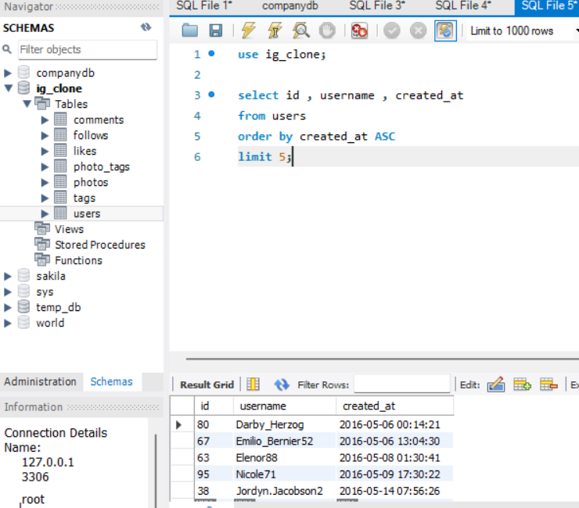
Marketing Analysis
Loyal User Reward: The marketing team wants to reward the most loyal users.
Thus we need to find out those who have been using Instagram for the longest time.
In this we have to use the followings keywords – select, from , order by , limit.

Slide 10
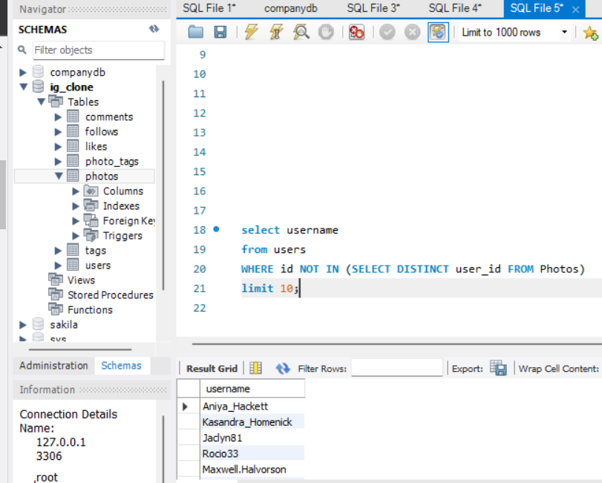
Marketing Analysis
Inactive User Engagement: To find inactive users to start posting by sending them promotional emails.
To do this we need to find out all the users who have never posted even a single photo on Instagram.
Since there are many users who have not posted for a while I have choosed to display 10 people who have not posted a photo.
In this we have to use the followings keywords – select, from , where , not in , limit , select distinct(no duplicates).

Slide 11
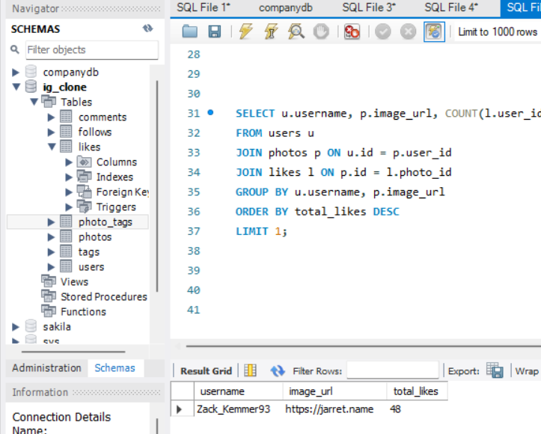
Marketing Analysis
Contest Winner Declaration: A contest is organized to find out which person has the maximum likes in a single photo.
One of the most challenging query in this project so far.
Using sql queries we found out the winner.

Slide 12
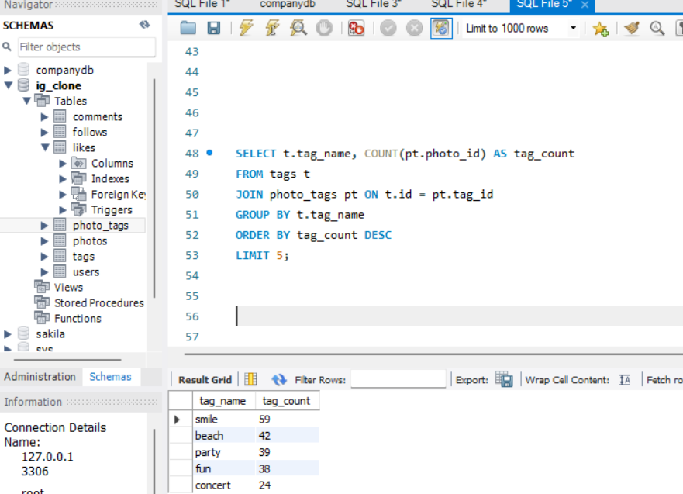
Marketing Analysis
Hashtag Research: To find out the most popular hashtag which will reach out to the maximum audience.
So the top 5 hashtags are shown using sql queries.

Slide 13
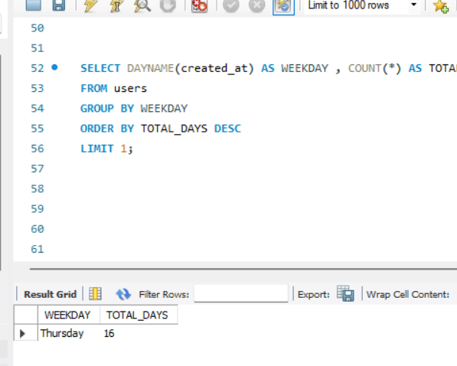
Marketing Analysis
Ad Campaign launch: The best time of the week to launch a campaign so that it reaches the maximum audience on Instagram.
To determine which day of the week is best suited for the campaign.

Slide 14
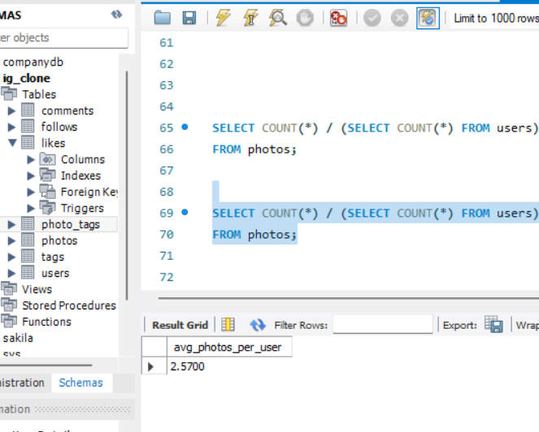
Investor metrics
User Engagement: To know if the users are active on Instagram or not. And to find the average number of posts per user on Instagram. And the total number of photos on Instagram divided by the total number of users.

Slide 15
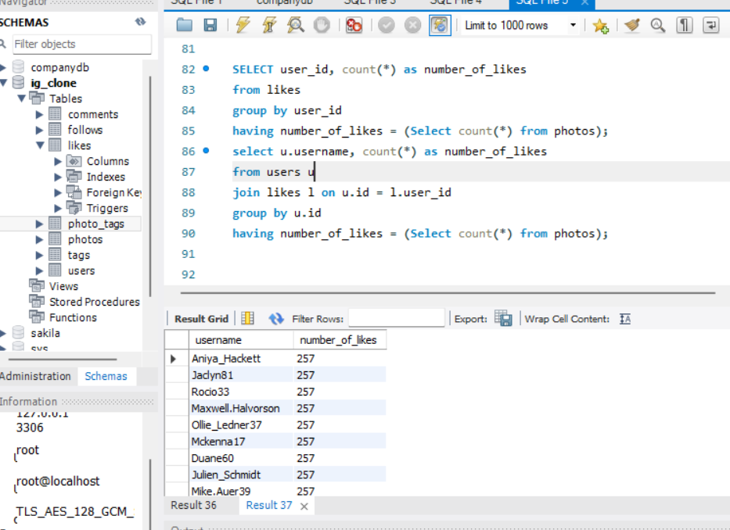
Investor metrics
Bots & Fake Accounts: to find out all the fake accounts.
Using sql queries we found out the fake accounts.

Slide 16
conclusion
Overall it was a very good project to gain complete and deep knowledge of SQL Fundamentals.
Sql is easy once your understand how it works.
To put it into practical knowledge and do data analytics projects using sql feels like a big achievement.
All of the desired outputs were satisfactory and doing this project made me more interested in data analytics.

Slide 17
Thank you.
.

